Slide 1





Project One Group Six
Sajid Anjum
Bekhem Horne
Japhet Mwamba
Han Le
How caffeinated are you?
A data breakdown of some caffeinated drinks on the market and their caffeine contents.
Notes:
[Han]

Slide 2
What is interesting about Caffeine?
Caffeine is one of the most popular drugs in the world
Average assumption is 70mg per person per day (54% from coffee, 43% from tea and 3% from other forms)
For healthy adults, the FDA has cited 400 milligrams a day—that's about four or five cups of coffee. For some, caffeine can increase anxiety, restlessness, tremors, irregular heartbeat, and sleeping trouble. Dead from caffeine is rare but possible
This project looks at different types of caffeinated beverages available and how they vary by caffeine and calories
Notes:
[Han]
Sources:
//efaidnbmnnnibpcajpcglclefindmkaj/https://www.mhc.wa.gov.au/media/1223/caffeine-the-facts-booklet.pdf - Drug and Alcohol Office - Government of Australia
https://www.fda.gov/consumers/consumer-updates/spilling-beans-how-much-caffeine-too-much
https://www.healthline.com/nutrition/coffee-calories

Slide 3
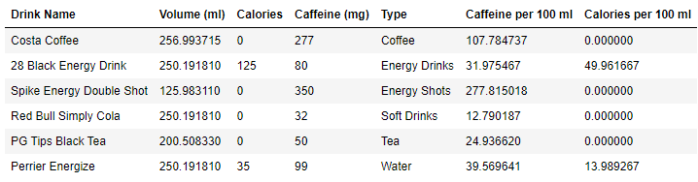
What can we say about some common caffeinated beverages?
Our Data Set:
https://www.kaggle.com/datasets/heitornunes/caffeine-content-of-drinks
What does it look like?
Notes:
[Han]
What the data set is (It is about a lot of energy drinks, their caffeine content.)

Slide 4
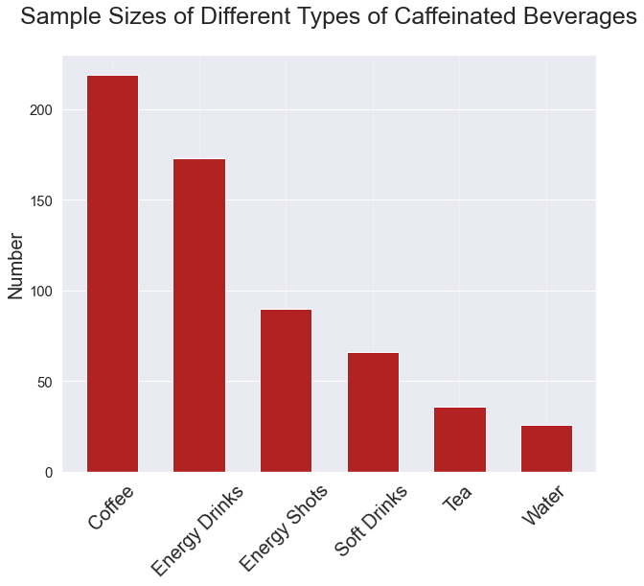
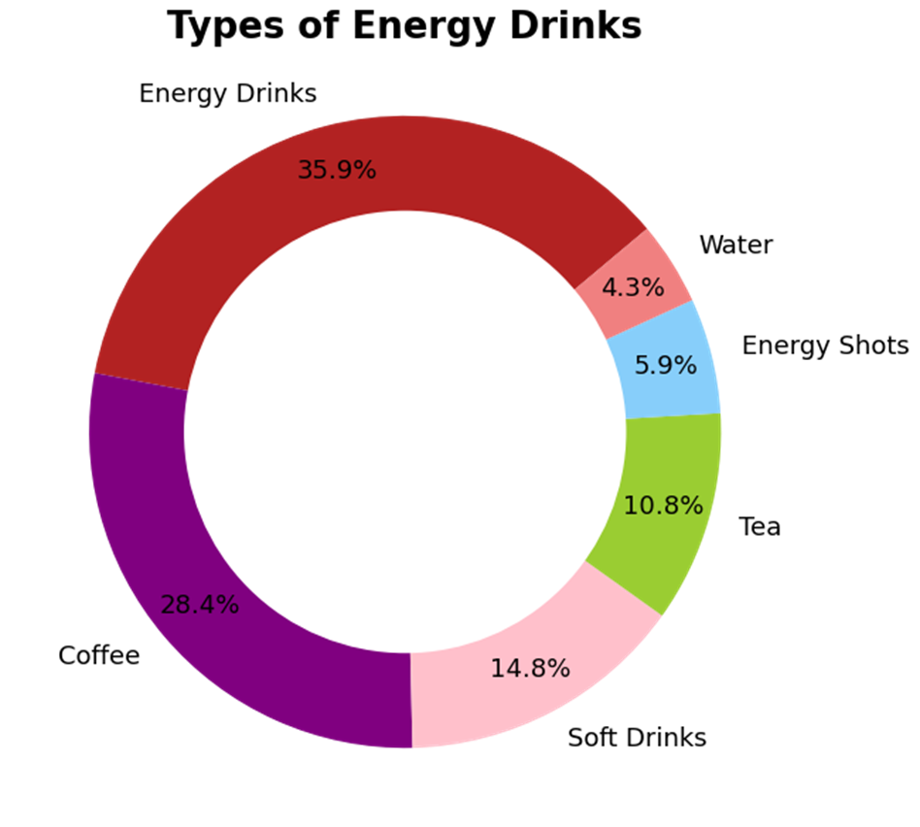
Summary of Data:
Six Main Drink Types
Total Sample Size = 610
Notes:
[Sajid]
*Speaking points and the breakdown of this visual representation provides.
*What question(s) does this donut chart show and answer.
In this Donut chart we can see that 64.3% of caffeinated drinks are energy drinks and coffees.
Two surprising point are 4.3% of waters on the market have caffeine and soft drinks only make up 14.8%

Slide 5
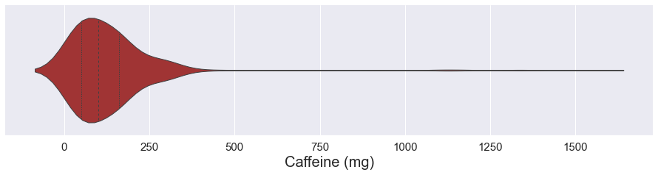
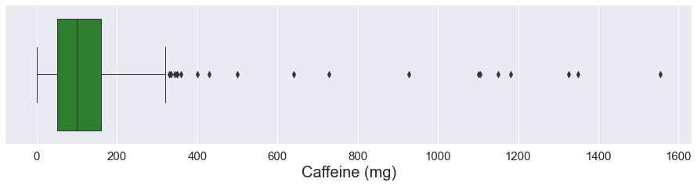
Summary of Data:
What does the distribution of caffeine look like?
Notes:
[Sajid]
*Speaking Points: The distribution is mostly normal except for a really long spine.
A boxplot will show that these are all outliers. 1st, 2nd, 3rd quartiles. We created a box plot to further investigate the violin plots long spine

Slide 6
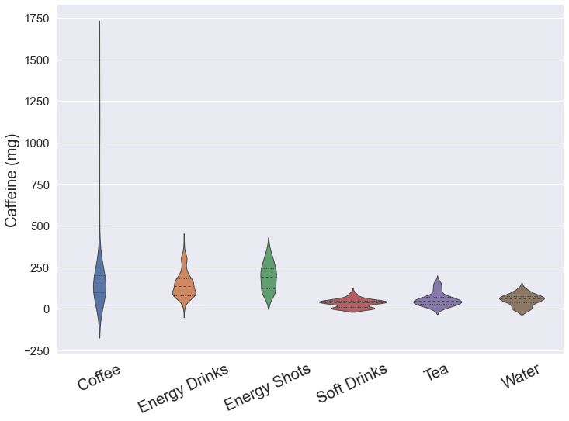
Summary of Data:
Where are the outliers?
On the left are violin plots of the distribution of caffeine in different types of energy drinks.
Coffee is the only beverage which you can order with more than 500 mg of Caffeine, all the way up to almost 1750 mg.
The FDA does not recommend an intake of more than 400 mg of Caffeine per day.
Notes:
[Sajid]

Slide 7
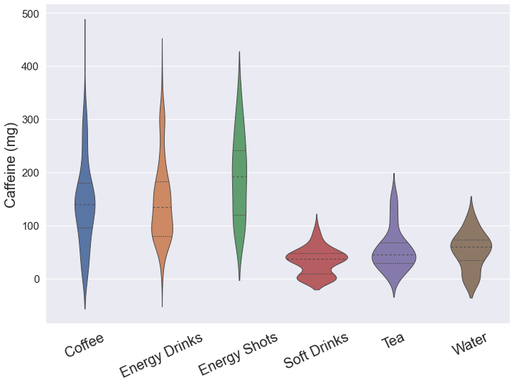
Summary of Data:
Let us remove the outliers
If you need to wake up, you need some coffee, energy drinks, or energy shots.
Data filtered to remove beverages with more than 500 mg of caffeine.
If you need a mild buzz, soft drinks, tea, or water will suffice.
If you need a trip to the emergency room, coffee is your best bet.
Notes:
[Sajid]
*Speaking Points: Speak a little bit about the shape of the distributions.
They are quite symmetrical now.
Three on the left are more spread out than three on the right.
Energy shots have the highest median.
Soft drinks is bimodal because many soft drinks have no caffeine at all.

Slide 8
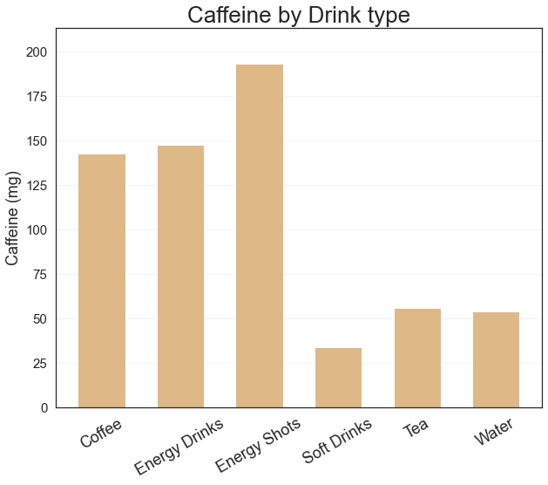
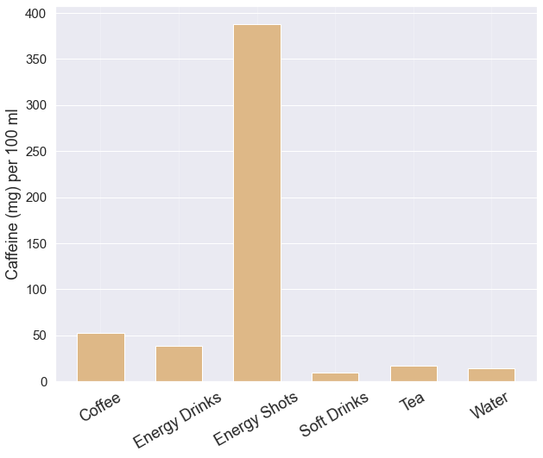
Average Caffeine Content of Different Types of Drinks
Mean Caffeine content by drink type
Mean Caffeine per 100ml by drink type
Data filtered to remove beverages with more than 500 mg of caffeine.
Data filtered to remove beverages with more than 500 mg of caffeine.
Notes:
[Sajid]
As the distributions after filtering are symmetric, the mean caffeine content is very similar to the medians of the violin plots.
When we tried to analyze mean caffeine content per 100 ml, we noticed that Energy shots are an extremely concentrated dose of caffeine, while you need to drink a lot of soft drinks to get caffeine.

Slide 9
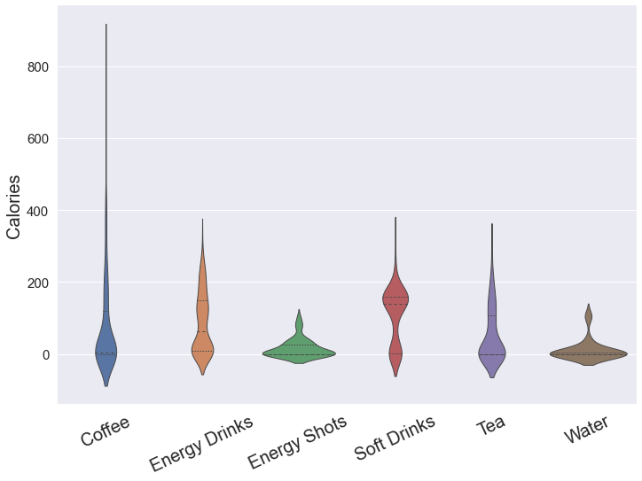
What are the best types if you are counting calories?
On the left are violin plots of the distribution of calories in different types of energy drinks.
Again, we see that coffee really wants to be rogue.
We also see that all the violin plots have their modes at 0 and many have two modes – Diet and Regular
Note: there is no such thing as negative calories. I am sorry to disappoint you. Violin plots are predictive density plots.
Notes:
[Bekhem]

Slide 10
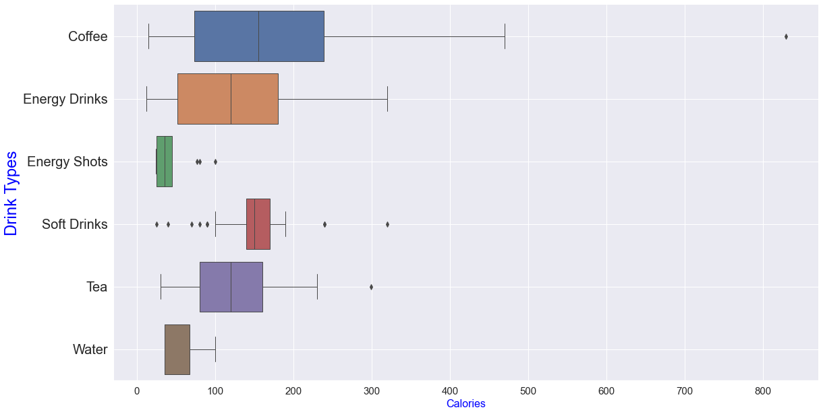
What are the best types if you are counting calories?
This distribution is filtered to exclude diet energy drinks (energy drinks with 10 calories or less)
No filtration done for energy shots, water, and tea since majority are low calorie.
Coffee is no longer so rogue
Soft Drinks outliers are weirdly symmetric
We will get rid of outliers.
Notes:
[Bekhem]

Slide 11
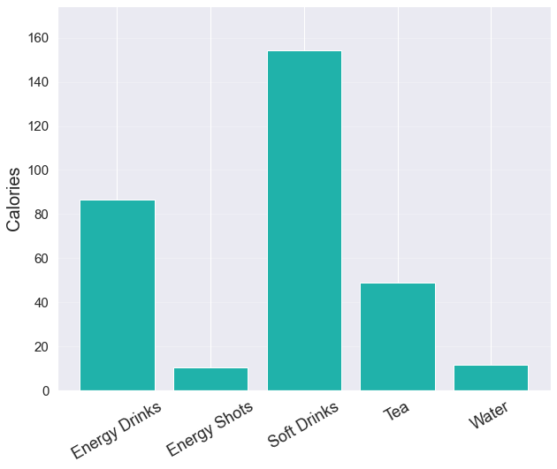
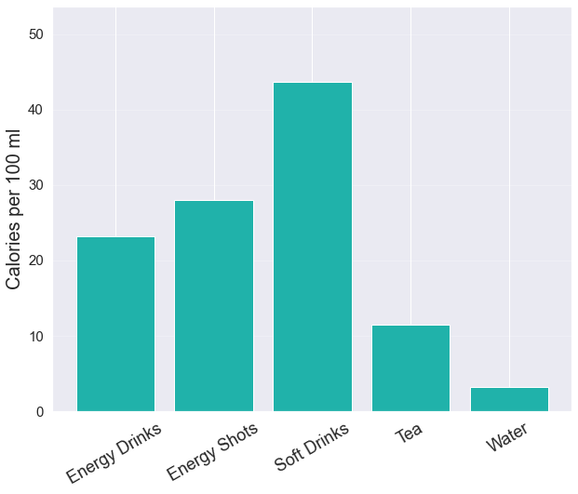
What are the best types if you are counting calories?
Data filtered to remove diet beverages and any outliers.
Mean
Mean
Notes:
[Bekhem]
Energy shots are very good if you are counting calories. Soft Drinks have even more calories per 100 ml than energy shots despite energy shots being so small.

Slide 12
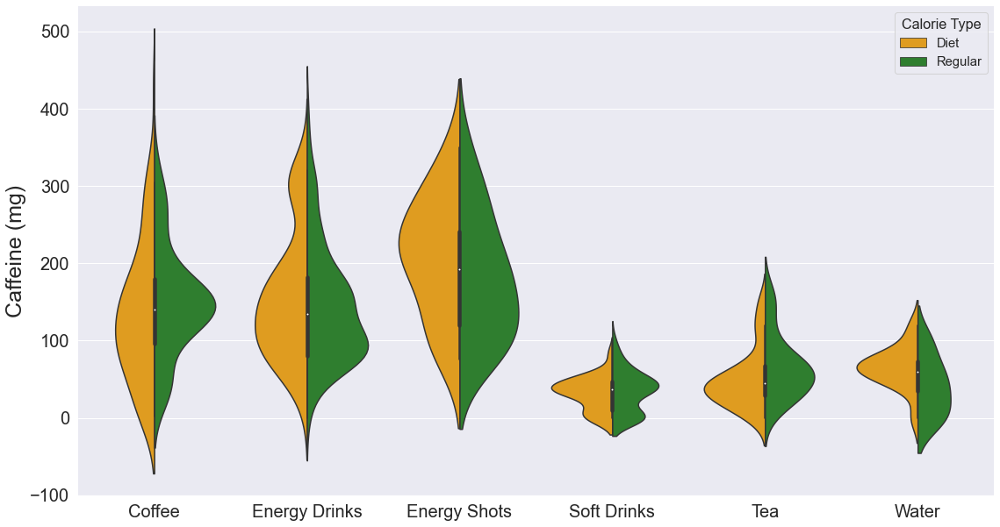
Compare Caffeine Distribution for Diet versus Regular.
Data filtered to remove beverages with more than 500 mg of caffeine.
Notes:
[Bekhem]
*Speaking Points: Speak a little bit about the shape of the distributions.
Caffeine content does not vary very much for regular versus diet. In fact, for Energy Shots and energy drinks, caffeine content is higher for diet drinks.

Slide 13
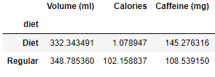
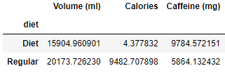
Compare Caffeine Distribution for Diet versus Regular.
Means
We saw on the previous slide that the distributions of caffeine for diet and regular drinks were not that different.
Variances
We can run a T-Test to decide how likely it is that both caffeine distributions are from the same parent distribution.

Slide 14

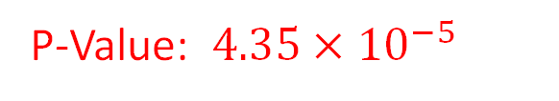
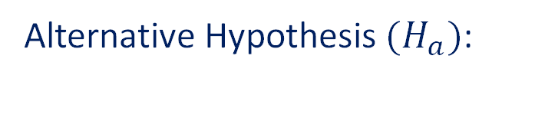
Compare Caffeine Distribution for Diet versus Regular.
Null Hypothesis $(H_{0})$:
The distribution of caffeine in the populations of diet and regular caffeinated beverages is the same.
Alternative Hypothesis $(H_{a})$:
The distribution of caffeine in the populations of diet and regular caffeinated beverages is different.
TTest Statistic: 4.173
Using Stats library from Scipy
P-Value: $4.35×{10}^{−5}$
Conclusion:
The distribution of caffeine in the populations of diet and regular caffeinated beverages is different.

Slide 15
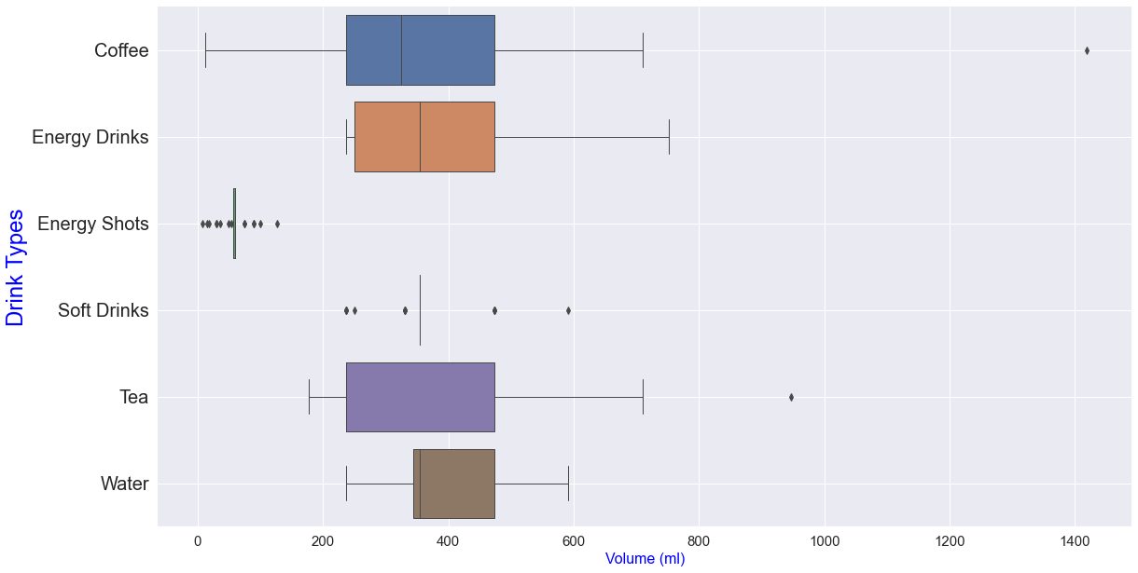
How do the volumes compare?
Energy shots and soft drinks prefer a very definite size.
Coffee and Tea have a ginormous outlier each.
Notes:
[Bekhem]

Slide 16
Some Correlation and Regression

Slide 17
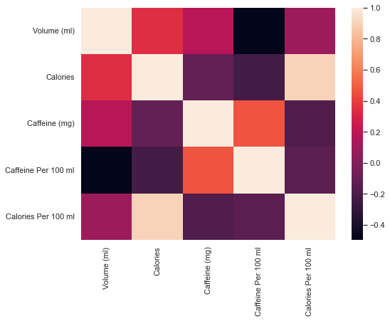
Correlation between Calories, Caffeine & Volume
This is a heatmap of how volume, calories, and caffeine relate to each other.
This data has been filtered to remove volume, calorie, and caffeine outliers.
As volume increases, caffeine per 100 ml decreases.
As volume increases, the number of calories increases.
Notes:
[Sajid]

Slide 18
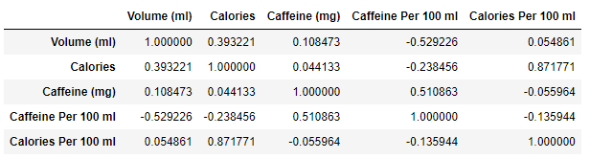
Correlation between Calories, Caffeine & Volume
These are the correlation coefficients for the previous heatmap
Some Questions:
Can we use volume to predict the concentration of caffeine per 100 ml?
Can we use volume to predict the number of calories?
Do total calories correlate with the density of calories per 100 ml?
Notes:
[Sajid]

Slide 19
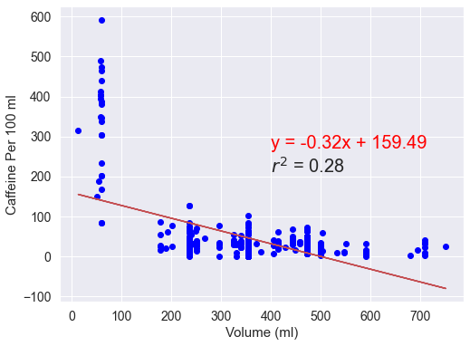
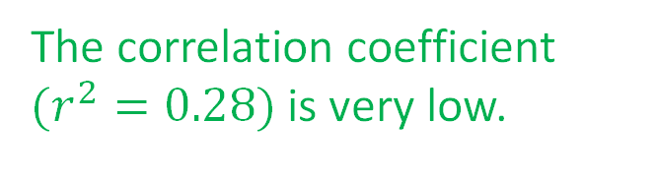
Density of Caffeine (per 100 ml) Versus Volume (ml)
The correlation coefficient $(r^{2}=0.28)$ is very low.
The graph is oddly shaped. The long line of blues on the left is clearly the energy shots.
If you ask me, there is no correlation at all.

Slide 20
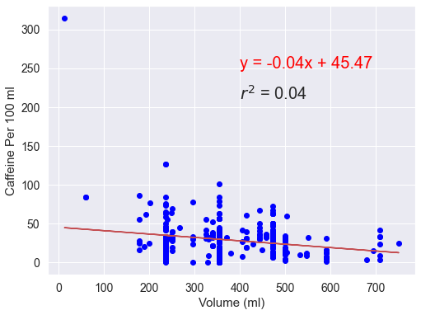
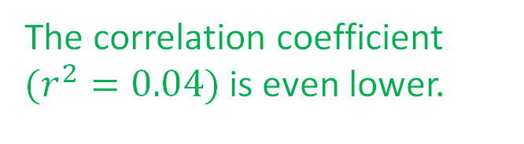
Density of Caffeine (per 100 ml) Versus Volume (ml)
This new graph is after filtering for energy shots.
The correlation coefficient $(r^{2}=0.04)$ is even lower.
Conclusion: Just because a drink is small in size doesn’t mean it is more caffeine dense.
Energy shots follow their own rules.

Slide 21
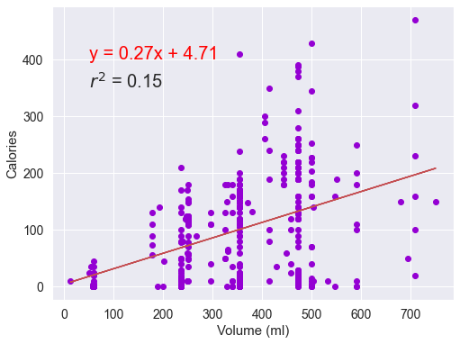

Calories Versus Volume (ml)
The correlation coefficient $(r^{2}=0.12)$ is very low.
Surprise! A bigger drink does not mean it has more calories!
Remember that we have already filtered out the diet drinks.
The zeroes that you see are mainly teas, waters, and energy shots.

Slide 22
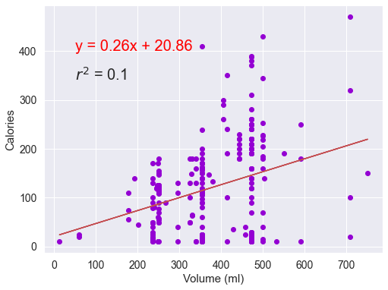
Calories Versus Volume (ml)
What if you focused only on Coffee and Energy Drinks?
It is EVEN WORSE!
A larger coffee or energy drink does NOT mean more calories.
Recall that we have already filtered out all the diet drinks.

Slide 23
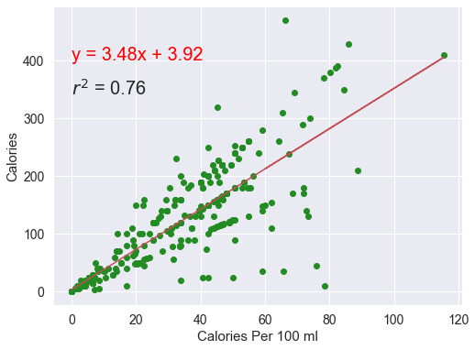
Density of Calories (per 100 ml) Versus Total Calories
There is a very high correlation!
76% of the variation in calories can be predicted by the variation in the density of calories.
This confirms the result on our previous slide. A larger drink is not a good predictor of the number of calories.

Slide 24
Let’s look at the highest and lowest caffeine drinks by type
Take a guess, which chart do you think will have the most interesting results?

Slide 25
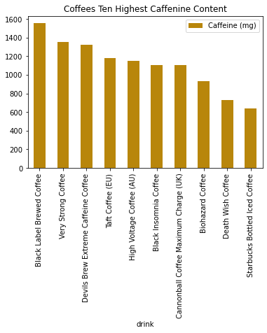
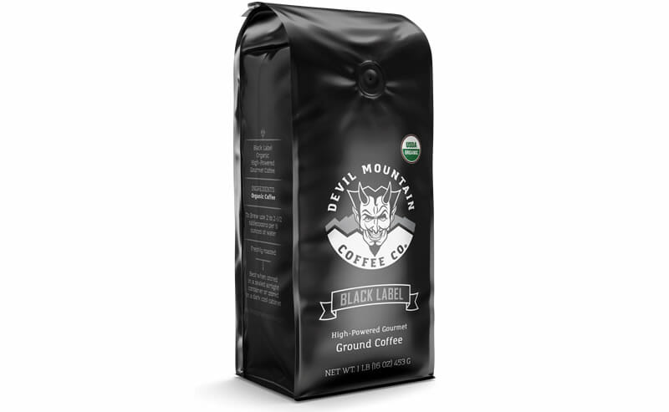
With a multitude of ways to be brewed, Coffees top ten highest caffeinated drinks are well above the recommend amount.
FDA recommended amount a day = 400mg
Notes:
[Bekhem]

Slide 26
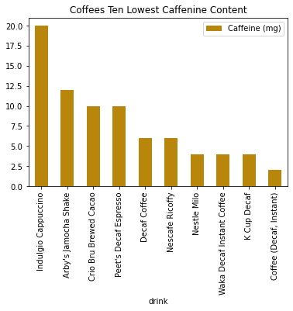
Several groupings for 10mg, 6mg and 4mg
Steady decline
No surprise the lowest ten for coffee has an abrupt decline as we locate the Decaf options in our data.

Slide 27
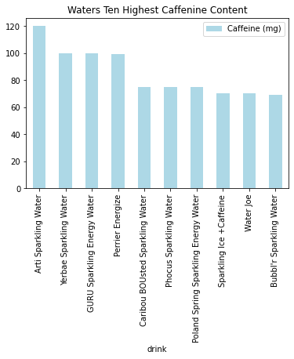
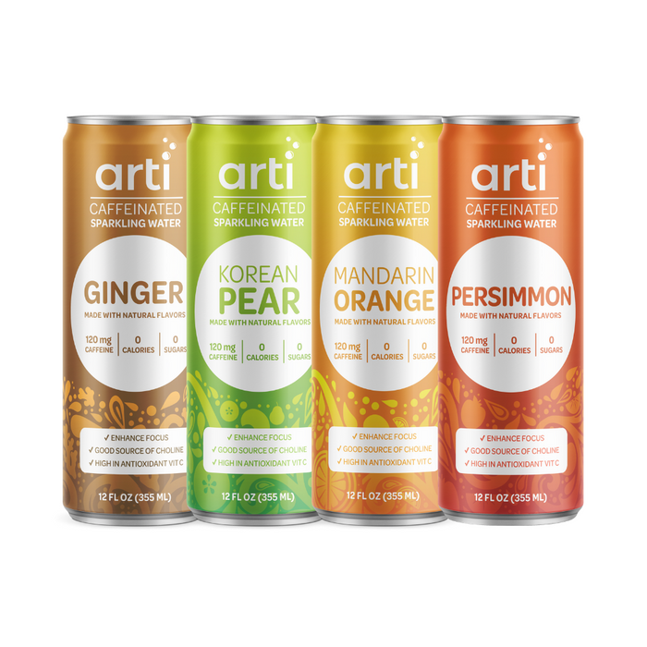
Notes:
[Bekhem]

Slide 28
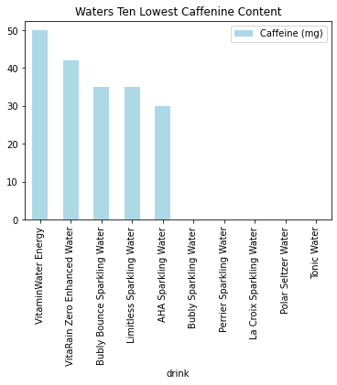
What do we have here?
We’ve found the outliers within our water types!

Slide 29
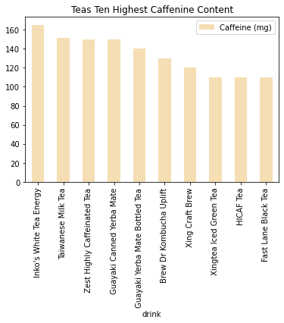
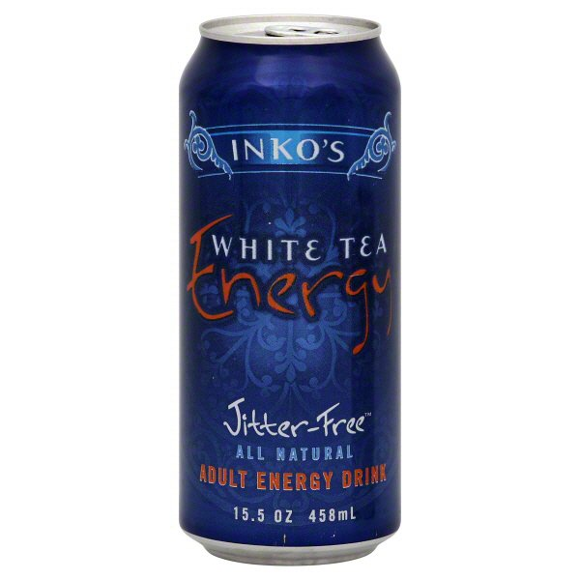
Notes:
[Bekhem]

Slide 30
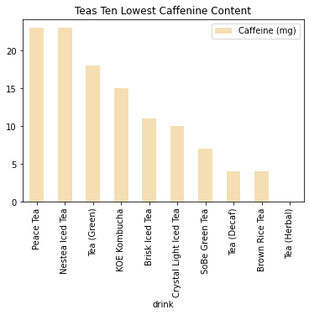
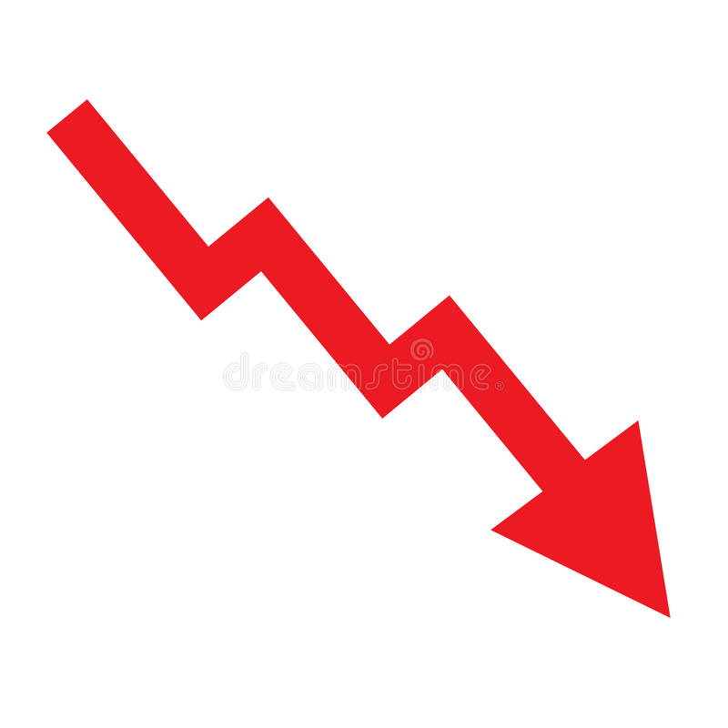
If you prefer to supplement your caffeine throughout the day, these top ten lowest caffeinated teas would be your best choice to avoid the jitters.

Slide 31
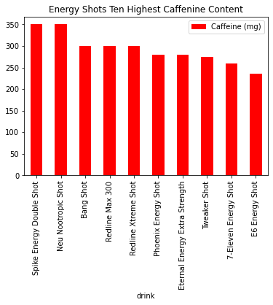
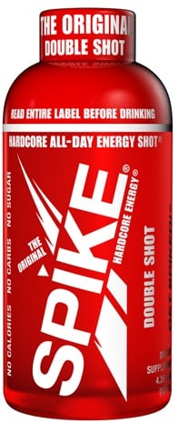
Big things come in small packages!
Notes:
[Bekhem]

Slide 32
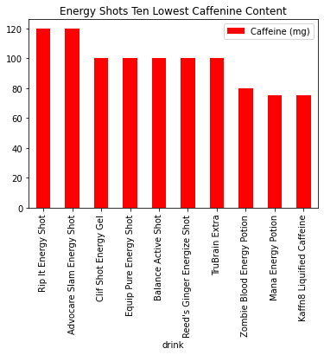
Energy shots show the least variance from top highest to top lowest!

Slide 33
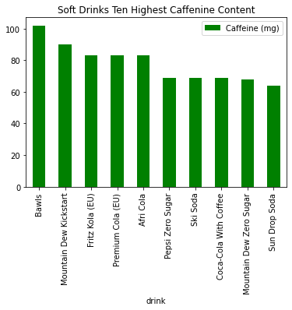
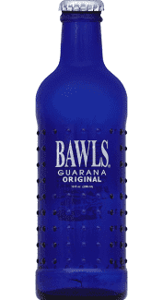
90’S THROWBACK!!
Notes:
[Bekhem]

Slide 34
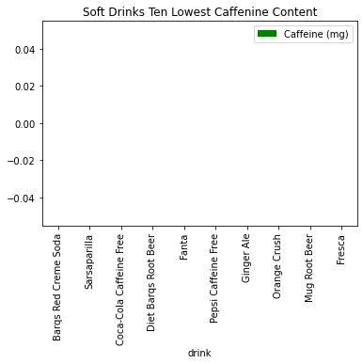
Did you guess Soft Drinks top tens would be the most drastic change?
More outliers!

Slide 35
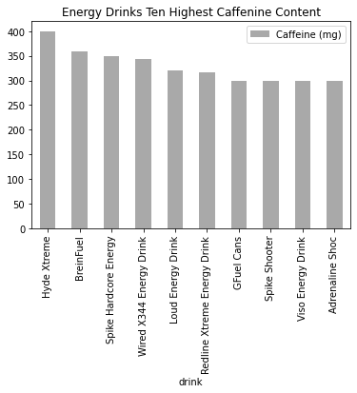
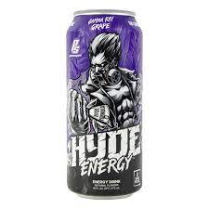
Energy drinks are a close second to coffee but the 400mg in a Hyde extreme would still do the trick.
Notes:
[Bekhem]

Slide 36
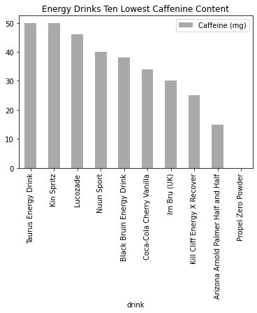
Nice even decline in caffeine content

Slide 37
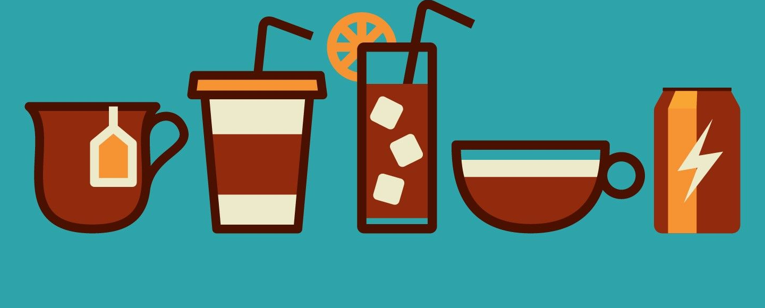
How much caffeine in your favorite brands?

Slide 38
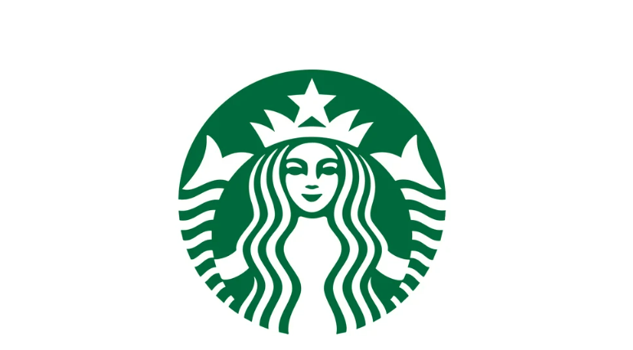

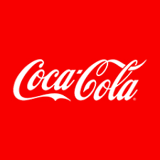


Common Brands
Notes:
[Han]

Slide 39


Starbucks | 27
Monster | 21
Coca Cola | 11
Peets | 10
Dunkin | 10
*Other: 531
Notes:
Other 553 did not include in the chart

Slide 40
Brand Analysis!
We are going to take a tour of all the drinks in the different brands and see how they vary by caffeine (mg) and by caffeine density (mg per 100 ml)

Slide 41

All the Peets products have the same volumes except for the Coffee Expresso and Decaf Expresso
The most caffeinated Peet drink is Brewed Coffee with 267mg for 473ml (~16oz)
Peet's Coffee Expresso and Decaf Expresso have the least amount of caffeine, but their volumes are only 1/10 of other drinks
Notes:
[Han]

Slide 42

At 157 mg caffeine per 100ml (~ 3 oz), Peet's Coffee Expresso has the highest caffeine content per 100 ml of the Peet products
Other products except for the Brewed Coffee, the caffeine content is in the range of 30 to 35 mg per 100 ml
Notes:
[Han]

Slide 43


Bottled Ice Coffee contains 640mg caffeine per 48fl oz bottle – highest among the Starbucks product – exceeds the 400mg recommended
Notes:
[Han]

Slide 44


Starbucks 2x Coffee Pod contains 110 mg of caffeine per 100 ml, the highest among the products. 1.5x of the second one, Canned Nitro Cold Brew
Most of the products contain less than 50mg of caffeine per 100ml.
The Refreshers Canned, Refreshers, Pink Drink and Decaf Coffee have the lowest caffeine content which is less than 15mg per 100 ml.
Notes:
[Han]

Slide 45

The top 4 with highest caffeine content has at least 210 mg per drink, led by the Iced Coffee with 297 mg.
The next group is in the range from 100mg to 200 mg.
Tea has the least caffeine content.
Notes:
[Han]

Slide 46


At 60 mg caffeine per 100ml (~ 3 oz), Extra Charged Coffee has the highest caffeine content per 100 ml of the Peet products.
Extra Charged Coffee packs 20% more caffeine than classic Hot and Iced Coffee
(The additional caffeine is extracted from the coffee bean before going the roasting process – to keep the same flavor)
Notes:
[Han]

Slide 47

Java Monster appears to contain the same “Energy Blend” as regular Monster. But the coffee extract adds appx 40mg of caffeine, making Java Monster the highest in caffeine among the products in the sample.
Most of Monster drinks stay below 200 mg and have more than 130mg of caffeine in the can.
Notes:
[Han]

Slide 48

Java Monster also has the highest caffeine content per 100ml, at 67mg
​
A big group of Monster stays at 34 mg per 100ml and the lowest is at 25mg.
Notes:
[Han]

Slide 49

Among all the Coca-Cola drinks in this sample, Coca-Cola Energy has the most caffeine content at 114 mg per 354 ml (12oz) drink, followed by Coca-Cola with coffee at 69 mg. Others stay at 34mg
This is 3 to 5 times less than coffee!
Notes:
[Han]

Slide 50

Notes:
[Han]

Slide 51

This violin plot shows the distribution of caffeine in some of the most common brands.
Notes:
[Han] I recommend that you make some notes about what you are going to say here.

Slide 52

This violin plot shows the distribution of caffeine density per 100 ml.
Notes:
[Han]

Slide 53

Some types of water do contain caffeine!!

Slide 54

Energy water contains caffein that varies from 50mg to 100mg per bottle.

Slide 55

Energy water contains caffein that varies from 50mg to 100mg per bottle.
The caffeine content per 100 ml is in the range from 8 to 28 ml.

Slide 56

While some sparkling water does not contain caffeine, most of the sparkling water has the caffeine content that varies from 30 mg and up to 120 mg.
The caffeine content per 100 ml ranges from 8 to 34 mg.
Most sparkling water bottles have the same size.

Slide 57
Some Conclusions
There are not strong relationships between volume, calories, and caffeine content within our sample size of 610 drinks.
Overall, the type of caffeine that has the widest ranges of caffeine is coffee.
Based on the sample of some common brands we picked, we observed that coffee brands (Peets, Starbucks, Dunkin') have wider caffeine distributions compared to soft drinks (Coca-Cola) and energy drinks (Monster). This means that if you want a strong buzz. Coffee is your best bet.

